Slide 1

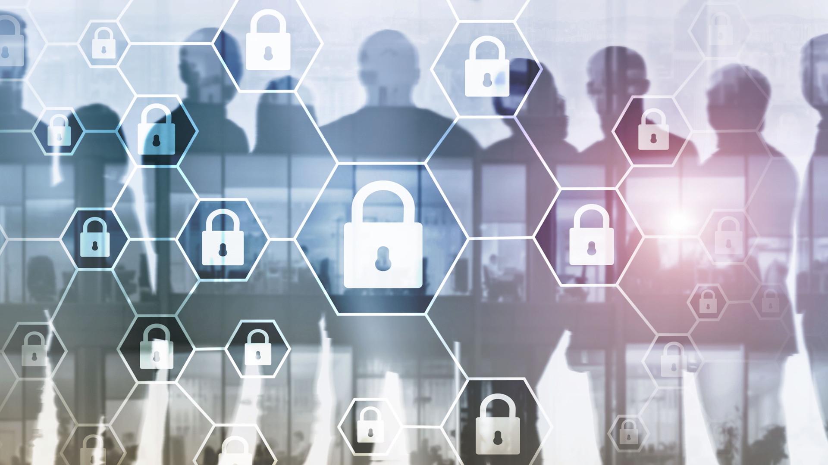
Company Name and Logo
Your Company
Cybersecurity Training
Protect yourselves online by mastering cybersecurity
best practices
Week 1
www.YourCompany.com
Notes:
Show this training slide before conducting the cybersecurity training session training

Slide 2


Introduction
Welcome to this training session
Cybersecurity Training
Notes:
Welcome your employees and other attendees to this training session.
Provide a few reasons why your company has decided on this training session. Limit this to the three most important reasons.
Go around the room and ask the participants about any expectations they want to get out of this training.

Slide 3
Introduction
Importance of this training session
Cybersecurity Training
Notes:
Explain the importance of cybersecurity training with the following pointers.
I. They (employees) are often the first line of defense against cyber threats.
II. Cyber attacks can have serious consequences, including data breaches, financial losses, and damage to a company's reputation.
III. By training employees, the company can minimize the risk of cyber-attacks and
IV. Incident reporting can help companies respond quickly and effectively to cyber incidents, mitigating the impact of an attack.

Slide 4







Course Overview
Basic Concepts
Device Protection
Social Media and Web Browsing Safety Guidelines
Social Engineering
Cybersecurity Incident Reporting
Mobile Device Security
Notes:
Summarize the topics that will be covered in this training program.
I. Basic Concepts
II. Device Protection
III. Social Engineering
IV. Social Media and Web Browsing
V. Mobile Device Security
VI. Incident Reporting
Let them know that you will elaborate more on these topics when we get to them.

Slide 5
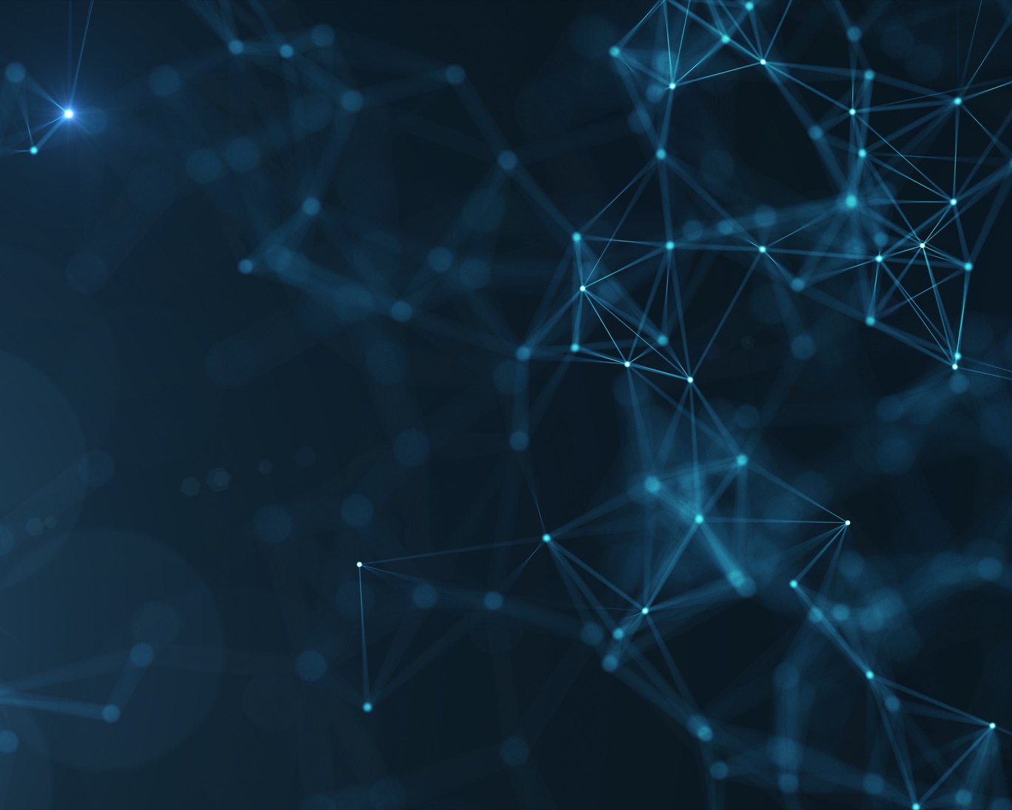
Why is CYBERSECURITY Important
"If you put a key under the mat for the cops, a burglar can find it, too. Criminals are using every technology tool at their disposal to hack into people’s accounts. If they know there’s a key hidden somewhere, they won’t stop until they find it."
Tim Cook
Notes:
You can give the inspiration to put importance on cybersecurity.
In this example, we used a quote as an inspiration.

Slide 6
Why is CYBERSECURITY Important
Critical Information at risk
Company Information
Clients Information
Vendors and Partners Information
Notes:
Discuss the potential of endangering important and critical information.
I. Company data such as employee information, financials, and operations can be compromised
II. Our company information and clients' sensitive information can also be compromised.
III. Additionally, information about vendors and partners can be compromised.
Let them know that all these can have negative effect on the company and it’s operations. The potential of damaging everyone increases when information in compromised.

Slide 7
Why is CYBERSECURITY Important
To protect the company's Brand
and Reputation
Destroy relationships with customers
Loss of trust
Damage to Company's Brand
Notes:
If we don't protect our customers' information, some consequences would be:
I. People will think less of your business—reputation damage.
II. Customer relationships would be ruined—relationship Damage.
III. The brand would be destroyed—brand Damage.
In many instances, all these cause irreparable damage.

Slide 8
Why is Cybersecurity Important
To avoid litigation
Affected clients may want to sue the company
The sued company might not survive
Jobs will disappear
Notes:
Discuss Lawsuits and Litigations
I. Besides stopping operations and data, your company might get sued.
II. This might kill the company, and your staff will lose their jobs.

Slide 9
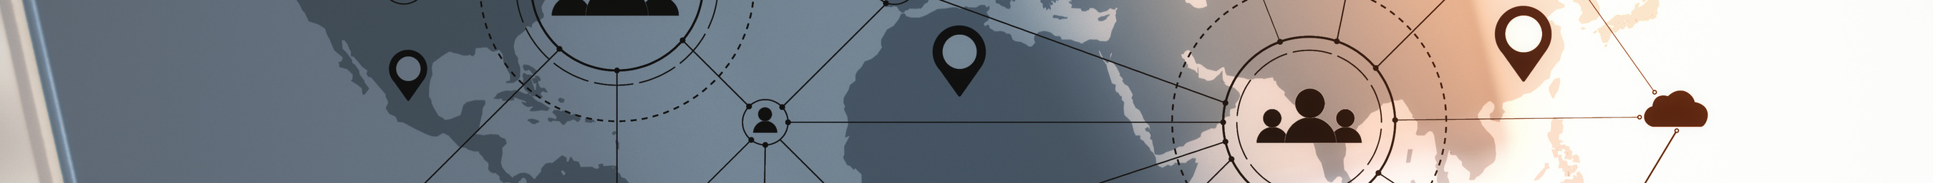
Basic Concepts
Notes:
Let them know that this next section, we will be discussing some "Basic Concepts" on Cybersecurity.
*This slides represents the next section*

Slide 10
What is Cybersecurity?
Protecting Devices
Procedures and Technologies
Safeguard Information
Notes:
First, speak of and define Cybersecurity.
Read or discuss the following bulletpoint explanation.
I. Protecting Devices - Cybersecurity is the practice that protects computers, servers, mobile devices, electronic systems, networks, and data from digital attacks, theft, damage, and unauthorized access.
II. Procedures and Technologies - It involves using technologies, processes, and practices to protect your digital assets from viruses, malware, phishing attacks, and hacking attempts.
III. Safeguard Information - It safeguards the organization's information, prevents data breaches, and ensures data confidentiality, integrity, and availability.

Slide 11
Common Misconceptions
Notes:
This sub-section will discuss some common misconceptions.
The following slides will cover some of these misconceptions you can make your staff be aware of.

Slide 12
Common Misconceptions
We have tools
No Guarantee
Determination is Guaranteed
Evolution of Technology
Notes:
The first misconception is that — We have tools.
Give the following pointers on why believing that we have tools to protect us from security threats is a misconception.
I. No Guarantee - Discuss that the tools available enhance security, but do NOT GUARANTEE it.
II. Determination is Guaranteed - Let them know that if someone is determined to gain access, they will find ways to.
III. Evolution of Technology - Inform them that Technology is constantly developing at a rapid rate. The tools we use today may not be not enough in a few weeks.
This is also true for cybercriminals, as they evolve and get smarter.

Slide 13
Common Misconceptions
Cybersecurity Insurance
Not preventative
Only after it happens
Downtime
Resources spend recovering
Notes:
Discuss the concept of why not to rely on cybersecurity insurance.
I. Nor preventative - It does not prevent cyberattacks.
II. Only after it happens - Only covers the cost after it happens; it is not preventive.
III. Downtime - You lose data and valuable time recovering rather than continuing critical operations.
IV. Resources spend recovering - Consider the wasted time and resources spent recovering from a cyber-attack.

Slide 14
Common Misconceptions
Dedicated team
Mistakes
Employees' Responsibilities
Downtime
Notes:
Discuss the misconception of a dedicated team.
I. Mistakes - People are still prone to make mistakes.
II. Employees' Responsibilities - Employees are still responsible for their actions and must take steps to protect the company's sensitive data
IV. Downtime - Consider the downtime to recover when the Team is called to respond.

Slide 15
Common Misconceptions
Small or Insignificant
Weaker security
Automated Target
Limited Resources
Notes:
Discuss why it is more important to protect your company even if you are a smaller company.
I. Weaker security - In reality, smaller organizations can be easier targets for cybercriminals as they may have weaker security measures.
II. Automated target - cyber-attacks are often automated and can target any organization, regardless of its size or industry
III. Limited Resources - Smaller organizations need more resources for robust, state-of-the-art cybersecurity measures.

Slide 16
Security Awareness and common threats
Notes:
Let your employees know that we will be proceeding with the next section.
This next section will discuss and provide you with some of the most common threats we can see out there.
It will also give you information and awareness on what to look out for.

Slide 17
Security awareness and common threats
Ransomware
Infiltrate Businesses
Unusable until Payments are made.
Unsuspecting email
Notes:
Explain that this one is covered in the news. Often, the media has covered stories on more prominent organizations that fell, victim. But this happens to all organizations regardless of the size of the company.
I. Infiltrate Business - Ransomware is malware often used to infiltrate businesses.
II. Unusable until Payments are made - It renders data and files unusable until an anonymous payment is made to the bad actors so that they can release your data.
III. Unsuspecting email - Ransomware often enters a network as an email. When an unsuspecting user clicks on a link in the email, they unknowingly grant entry to the party.

Slide 18
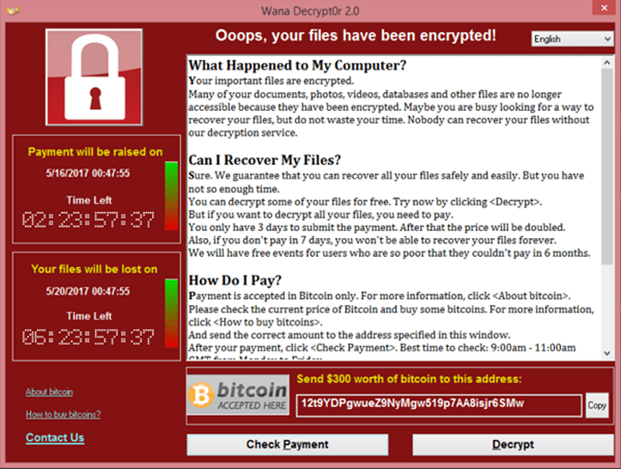
Security awareness and common threats
Ransomware
Notes:
Present this example of what Ransomware looks like.
Let them know that this is an example of ransomware.
The moment a message shows wanting to exchange your data with payment, you have fallen victim to ransomware.

Slide 19
Security awareness and common threats
Phishing
Tricking an Individual
Emails, messages or Phone calls
Installs Malware
Notes:
Discuss what phishing is.
I. Tricking an Individual - Involves tricking individuals into providing sensitive information or downloading malware.
II. Emails. messages or Phone Calls - It can take many forms, including emails, messages, or phone calls.
III. Installs Malware - When clicked, it can download malware onto the victim's device.
It is essential to be cautious of suspicious emails, messages, or phone calls and never to provide sensitive information to unknown sources.

Slide 20
Security awareness and common threats
Malware
Software that can harm
Example: Viruses, Trojans and Ransomware
Email and websites
Damage and data breaches
Notes:
Explain Malware to the attendees.
I. Malware - is a type of software that is designed to harm or disrupt computer systems, networks, and devices.
II. Example - It can come in many forms, including viruses, worms, trojans, and ransomware.
III. Emails and websites - Malware can be spread through infected email attachments, malicious websites, or unsecured networks.
IV. Damage and data breaches - Once installed on a device or system, malware can cause various issues, including data breaches, system crashes, and unauthorized access to sensitive information.

Slide 21
Security awareness and common threats
Outdated Software
Security Flaws
Prime target
Improves performance
Incompatibility
Notes:
Explain the importance of updating software.
I. Security Flaws - Outdated software will have security flaws, leaving systems vulnerable to cyberattacks.
II. Prime target - Outdated software is a prime target for cybercriminals to exploit because of their vulnerabilities
III. Improves performance - It improves the functionality and performance of the software.
IV. Incompatibility - Outdated software can also cause compatibility issues with other software and hardware, leading to errors.

Slide 22
Security awareness and common threats
Social Engineering
Send files
Gather information for an attack.
Gain your trust
Notes:
Explain some of the ways cybercriminals use social media.
First, define Social Engineering - Manipulating people into divulging confidential information. It's a confidence trick for information gathering, fraud, or system access.
I. Send files - The use of social media platforms to send infected files or links that can infect your computer or device
II. Gather information for an attack - Cybercriminals can use these platforms to gather information about individuals and organizations, which they can then use to launch targeted attacks.
III. Gain your trust - Criminals may pose as trusted sources, such as banks or government agencies, and ask individuals to provide sensitive information, such as login credentials or social security numbers.
Let them know the following - "Social Engineering" methods happen with and without using technology. They prefer technology as it provides anonymity and an easier means of communication.

Slide 23
Questions
Notes:
Ask the training attendees if they have any questions that need to be addressed.
Open this section for interactive discussion.

Slide 24
Recap and Takeaways
Notes:
Review what the attendees have understood and ask around what they have learned.
Ask them for a takeaway from today's session.
Asking around reinforces what they have learned and can also teach others.

Slide 25

Company Name and Logo
Thank you
for your attention
www.YourCompany.com
Notes:
Thank the attendees and congratulate them for completing this session.
Let them know to review the materials provided and that they can ask questions after this training session.
Remind them of the next session date and time.

